Slide 1

Rationale
Introduction to Windows Store App Development Using HTML5 and JavaScript
Computer science is a field of study that deals with solving a variety of problems by using computers.
  To solve a given problem by using computers, you need to design an algorithm for it.
Multiple algorithms can be designed to solve a particular problem.
An algorithm that provides the maximum efficiency should be used for solving the problem.
  The efficiency of an algorithm can be improved by using an appropriate data structure.
Data structures help in creating programs that are simple, reusable, and easy to maintain.
This module will enable a learner to select and implement an appropriate data structure and algorithm to solve a given programming problem.

Slide 2
Objectives
  In this session, you will learn to:
  Work with UI events
Notes:
2

Slide 3
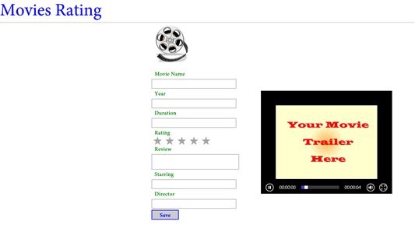
Demo: Making an App Functional
  Problem Statement:
  Nancy has created the UI of the Movie Rating app, as shown in the following figure.
Notes:
3

Slide 4
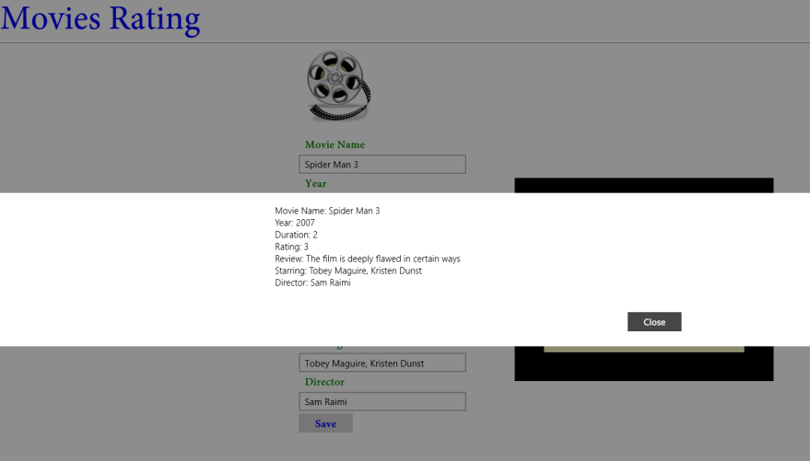
Demo: Making an App Functional (Contd.)
  Now, she wants that when the user clicks the Save button after specifying the movie details, the specified details should be displayed in a message dialog, as shown in the following figure.
  Help Nancy implement the preceding functionality in the app.
Notes:
4

Slide 5
Demo: Making an App Functional (Contd.)
  Solution:
  To implement the required functionality in the app, Nancy needs to perform the following tasks:
    1. Assign ID attributes to the UI elements.
    2. Add functionality to the Save button.
    3. Execute the app and verify the output.
Notes:
5

Slide 6
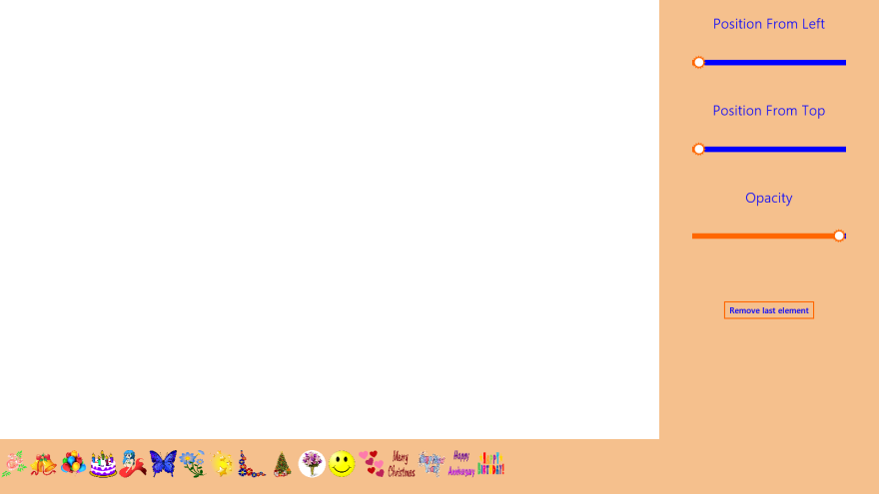
Demo: Card Decorator
  Problem Statement:
  Peter, an app developer at SoftTech Inc., has been assigned the task to develop a Card Decorator app that allows users to design greeting cards. A user can decorate a greeting card by using various images provided by the app. As an initial step, Peter has created the UI of the app, as shown in the following figure.
Notes:
6

Slide 7
Demo: Card Decorator (Contd.)
  Now, he has to enhance the app to enable the users to:
    Add images on the greeting card.
    Adjust the position and opacity of the last image added on the greeting card.
    Remove the last image from the card.
  Help Peter to add the preceding functionalities to the app.
Notes:
7

Slide 8
Demo: Card Decorator (Contd.)
  Solution:
  To enhance the preceding app, Nancy needs to perform the following tasks:
    1. Implement the functionality to add images on the card.
    2. Implement the functionality to set the position of the last image
    added on the card.
    3. Implement the functionality to set the opacity of the last image
    added on the card.
    4. Implement the functionality to remove last image from the card.
    5. Execute the app and verify the output.
Notes:
8

Slide 9
Summary
  In this session, you learned that:
  To handle an event associated with an app, you need to define an event handler.
Notes:
9

Slide 10

Q&A

